Slide 1
Why
MUST
we
DISCIPLINE?
“The practice of training people to obey rules or a code of behavior, using punishment to correct disobedience.”
(oxforddictionaries.com)
Part 2

Slide 2
TO PLEASE JESUS
TO DEMONSTRATE THE LOVE OF GOD

Slide 3
TO RECLAIM THE LOST
“deliver such a one to Satan for the destruction of the flesh, that his spirit may be saved in the day of the Lord Jesus.”
—1 Corinthians 5:5
1Cor. 5:1-5| Prov. 23:14 | Prov. 15:10-12

Slide 4
THE GOAL:
Have the erring saint learn his error
1 Timothy 1:20
Have the erring saint feel shame
2 Thessalonians 3:14
Retain the attitude that anticipates forgiveness and reconciliation
2 Corinthians 2:6-8

Slide 5
TO SAVE THE CHURCH
“Your glorying is not good. Do you not know that a little leaven leavens the whole lump?”
—1 Corinthians 5:6
“Wisdom is better than weapons of war; But one sinner destroys much good” (Eccl. 9:18)
1Cor. 5:6-12

Slide 6
“PUT AWAY FROM Yourselves The Evil Person”
Schoolmaster:
One who entices another to depart from the way in which the Lord commanded to walk (Deut. 13:5)
Idolater (Deut. 17:7)
Rebellious son (Deut. 21:21)
Sexually immoral (Deut. 22:21-30)
Gospel: take away, deliver to Satan, purge out, do not keep company

Slide 7
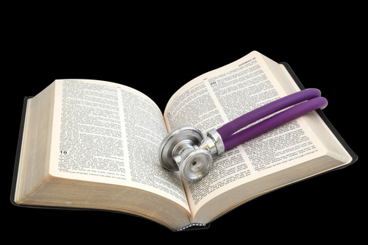
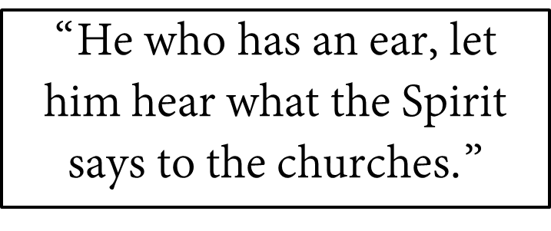
TO SAVE THE CHURCH
“For to this end I also wrote, that I might put you to the test, whether you are obedient in all things.”
—2 Corinthians 2:9

Slide 8
When
MUST
we
DISCIPLINE?

Slide 9
GUIDELINES:
Longsuffering & forbearing
Ephesians 4:2; 2 Timothy 2:24-26
Promptly
Prov. 13:24; 19:18; Eccl. 8:11; Titus 3:10, 11
Instructive → immediate
Punitive → after 2nd admonition

Slide 10
Matthew 18:15-20
Context: personal brother to brother sin (18:15, 21)
“Whoever commits sin also commits lawlessness, and sin is lawlessness” (1 Jn. 3:4)
Step not applicable to public sin

Slide 11
Matthew 18:15-20
1st Responsibility:
go and tell him his fault
In private: “alone”
Does not involve the church or any public knowledge
Conditioned Forgiveness: “If he hears you…”
“Gained” or “won”
1 Cor. 9:21, 22; 1 Pet. 3:1

Slide 12
Matthew 18:15-20
2nd Responsibility:
Take one or two others (18:16)
By the mouth of two or three every word may be established (cf. Deut. 19:15)

Slide 13
Matthew 18:15-20
3rd Responsibility:
Take it to the church (18:17-20)
No positive response—as a heathen and tax collector
The decision of the church reflects the courts in heaven
Jesus stands with the church when it disciplines those who persist in sin
Jesus opposes the church when it tolerates those in sin (Rev. 2:20)

Slide 14
John 21:15-17
15 So when they had eaten breakfast, Jesus said to Simon Peter, "Simon, son of Jonah, do you love Me more than these?" He said to Him, "Yes, Lord; You know that I love You." He said to him, "Feed My lambs."
16 He said to him again a second time, "Simon, son of Jonah, do you love Me?" He said to Him, "Yes, Lord; You know that I love You." He said to him, "Tend My sheep."
17 He said to him the third time, "Simon, son of Jonah, do you love Me?" Peter was grieved because He said to him the third time, "Do you love Me?" And he said to Him, "Lord, You know all things; You know that I love You." Jesus said to him, "Feed My sheep.
Mark 5:14
1 Peter 5:2; Acts 20:28
Notes:
Composite

Slide 15
Care enough to watch out for little ones
Matt. 18:10-14
Care enough to discipline those in sin
Matt. 18:15-20
Care enough to forgive those who repent
Matthew 18:21-35
Notes:
Composite

